Slide 1
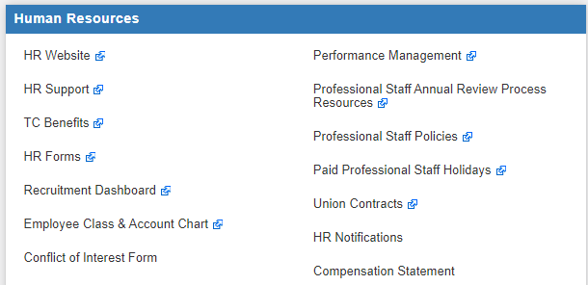
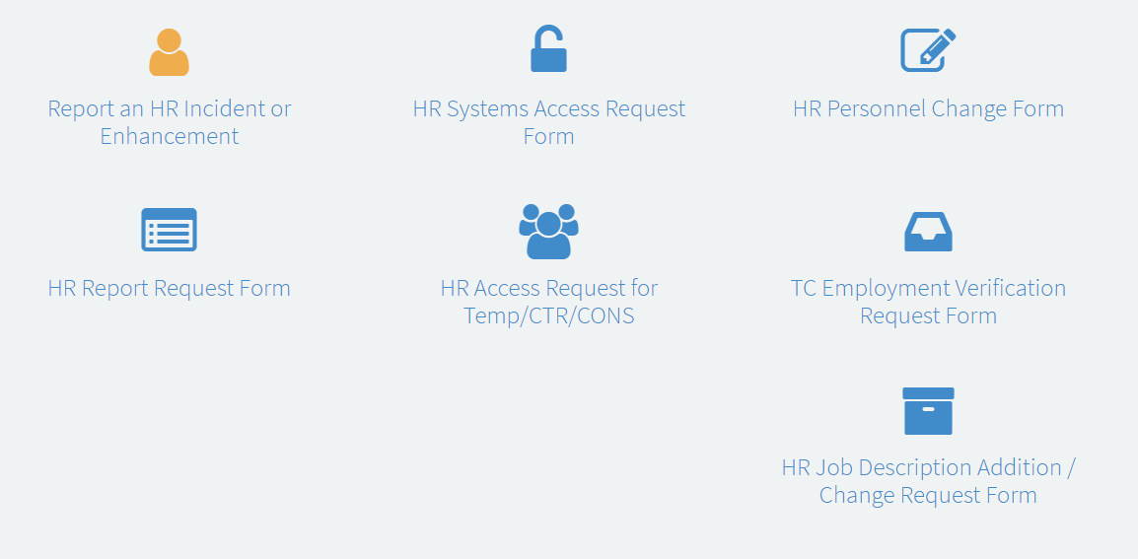
Job Description Request Form:
To request a new, or update an existing, Job Description you will need to complete the HR Job Description Addition / Change Request Form found under HR Support beginning July 10. This also applies to duties that are changing due to a promotion or salary adjustment.

Slide 2
When to Use the Job Request Form
Addition To Headcount
Increasing the number of total headcount in your Department. Ex., going from 7 employees to 8 employees)
Job Reclassification
The assignment of a new job profile that results in a change to the job duties, payscale and/or job family. Ex., taking a Program Manager position and reclassifying it as a Curriculum Designer.
Intention to promote an existing employee
Movement of an employee that is higher in pay and pay scale, at least 20% of the job has changed resulting in greater responsibility, moves vertically in the organization.
Modify duties with a salary change
Additional pay for additional duties, less than 20% of the job has changed resulting in greater responsibility
Modify duties with no salary change
Ex., decreasing the percentage of duties spent on filing and increasing the percentage of duties spent on scanning.

Slide 3
When NOT to Use the Job Request Form
To Create/Edit Student Job Descriptions
To Create/Edit PT Instructional Job Descriptions
To Create/Edit Interim Job Descriptions
If you do not have access to a student, pt instructional, or interim job description template, please contact your HR Generalist or assistance.

